Slide 1
CEN 3024C Presentation
Cole Morrison, David Smith, Anthony Greene, Dayne Wright

Slide 2
Agenda
Introduction, Elaboration, GitHub - Dayne Wright
Back End Development - Anthony Greene
Tools and Processes - Cole Morrison
Security - David Smith

Slide 3
Financial Clarity (Purpose and Inspiration)
As college students and aspiring Software Developers, we collectively understand the financial burdens that come along with pursuing our dreams of becoming Software Developers
While we cannot simply solve those problems with a push of a button or a wave of a wand, we can at least help in the tracking, planning, and maintenance of our day to day and unexpected finances.
That is why we started Financial Clarity, as a means to helps not just college students but potentially others as well in this area of their lives.
Our project was also inspired by a desire to demonstrate a comprehensive understanding of key concepts introduced in our coursework. We aim to develop a project with layered functionalities, allowing for both immediate interaction and potential future expansion.

Slide 4

Github
A Collaborative Development Platform
Enables developers to create, store, manage, and share code seamlessly.
Code Repository with Multi-User Collaboration
Provides a centralized location for code storage (repository), allowing multiple contributors to work together effectively.
Safe Code Modification and Management
Allows edits and change suggestions without affecting the main codebase, ensuring the stability of the project.

Slide 5
Key Features of GitHub
Branches: Allows developers to work on isolated code versions for specific features, bug fixes, or experimental changes. This enables parallel development workflows and reduces conflicts among team members.
Pull Requests: Encourages peer review and discussions before integrating changes into the main codebase. Pull requests streamline the collaboration process by providing a space for feedback, testing, and quality assurance.
Version History: Tracks all changes made to the code over time, making it easy to revert to previous versions if needed. This ensures accountability and provides a safety net for experimentation.
Merge Conflict Resolution Tools: Helps resolve discrepancies when multiple contributors make changes to the same parts of the code. These tools assist developers in integrating changes smoothly without losing progress or introducing errors.
Integrated CI/CD Pipelines: Enables automated testing, building, and deployment processes directly from the platform. This ensures code quality and accelerates the delivery of new features.
Access Control and Permissions: Ensures secure collaboration by allowing administrators to define roles and permissions for team members, protecting sensitive parts of the project while fostering teamwork.

Slide 6
Framework
Our project relies on five core entities that being User, Income, Expenses, Budget, Repayment Plan, and Saving.
Each user by default, will be required to fill out their Income and Expenses so that we can see money going in and money going out. This information with be stored with the Budget Entity so that it can be updated later if need be.
From here the User has a choice, is their goal to pay off debt or build a savings nest egg. Either will be stored in their respective entities and a plan will be built for the user in order to complete that goal.

Slide 7
Philosophy Debt Repayment
When it comes to paying off debt and saving for the future we take from the teachings of Dave Ramsey of the Ramsey Network.
We plan to incorporate the Snowball method for when Users decide to Pay off Debt which is as follows.
List all your debts from smallest to largest making minimum payments on all of them.
Starting with your smallest debt, put whatever extra money you have at the end of the month and attack that debt.
Once one is paid off, you take the extra money, and the minimum payment of the first debt and pay of the second debt. Then so on and so forth until all the debt is gone.

Slide 8
Philosophy Of Saving
Dave Ramsey also recommend the importance of a starter emergency fund of $1000.
This is to be used for those rainy days grandma and grandpa warned us about.
Cars need oil changes, electronic devices break, emergency ER visits happen. No one knows for sure if or when it’s going to rain but someday it will.
As the old saying goes, when it rains it pours. So keep you umbrella handy.

Slide 9
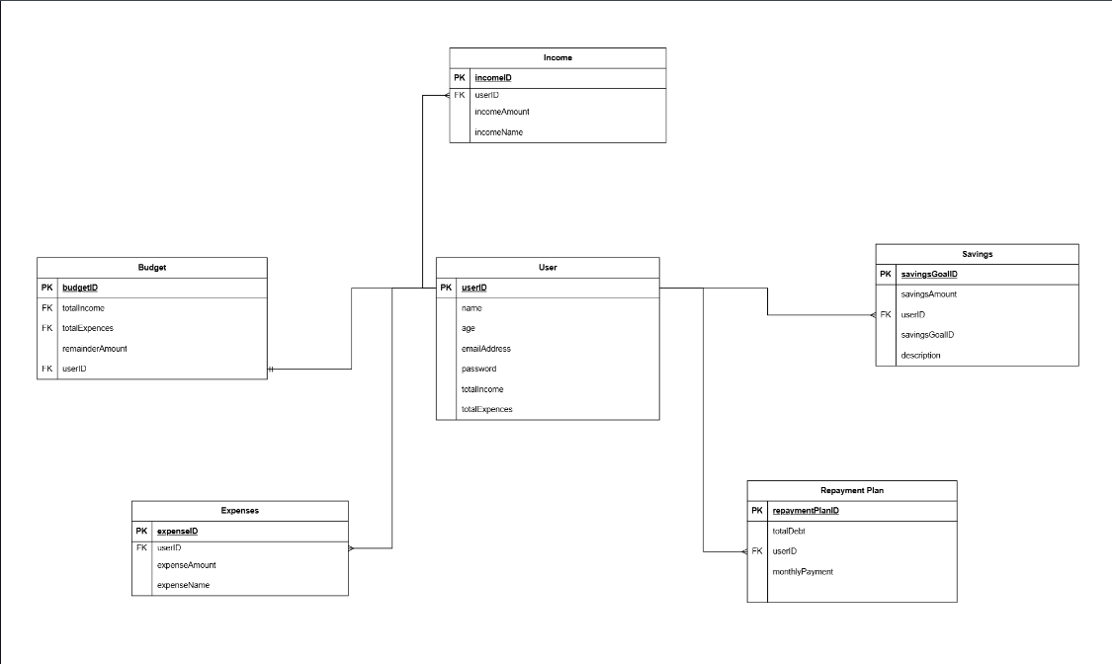
Database Outline
At the core of this application is the User with it’s One to many relationships.
Every user at minimum will have an Income, Expense, and Budget.
From there the User will decide based on their financial needs whether they want to Build a Saving Nest egg or Pay Off Debt with a Repayment Plan.

Slide 10
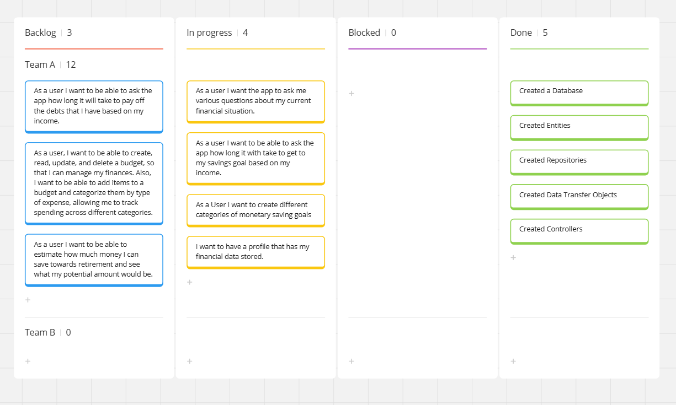
Progress Board (Presented on Miro Board)
Throughout this process, we will be using the Miroboard.
Backlog - things that we want to add but are not at the stage in the project.
In progress - Things that we either were or are currently working on.
Blocked - this is where we would put issues and constraints.
Done - things that are complete.

Slide 11
Tools and Processes
Tools:
Intellij: Integrated Development Environment (IDE)
Maven: Build tool & dependency management
Spring Boot: Framework
JPA Hibernate: Object-Relational Mapping(ORM)
Processes:
Branching Strategy
Pull Request

Slide 12
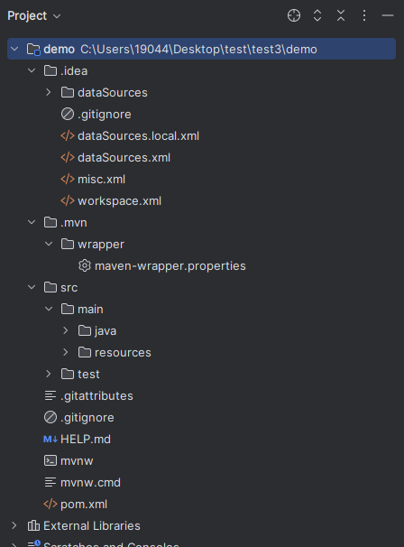
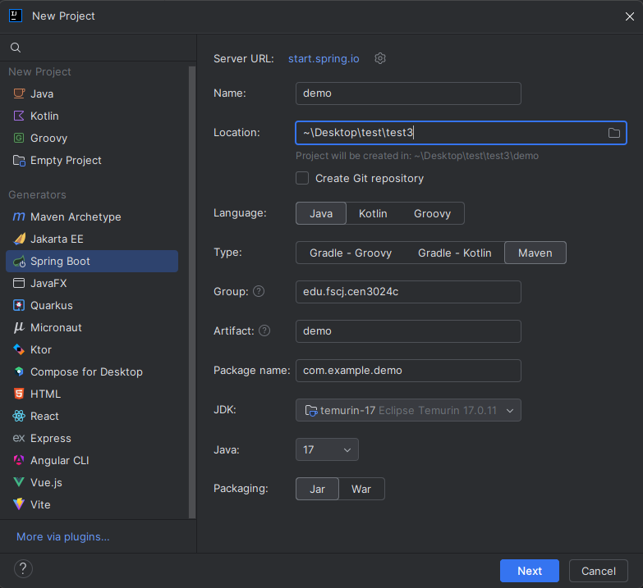
Intellij

Slide 13
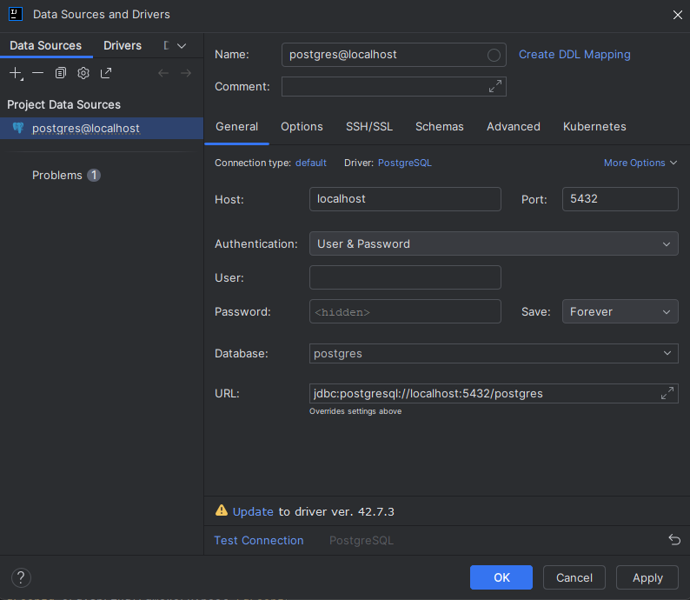

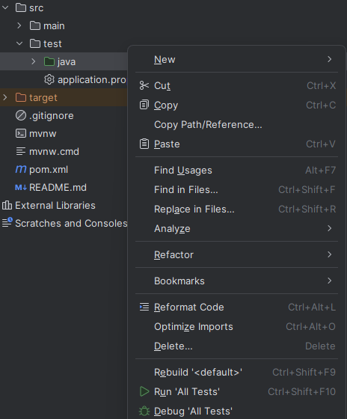
Intellij

Slide 14
Maven Overview
What is Maven?
Maven is an open-source CLI tool used for build automation and dependency management.
Key Features
Provides a standardized project structure.
Manages the project lifecycle, ensuring consistency across builds.
Utilizes a simple configuration file (pom.xml) to define project details and settings.

Slide 15
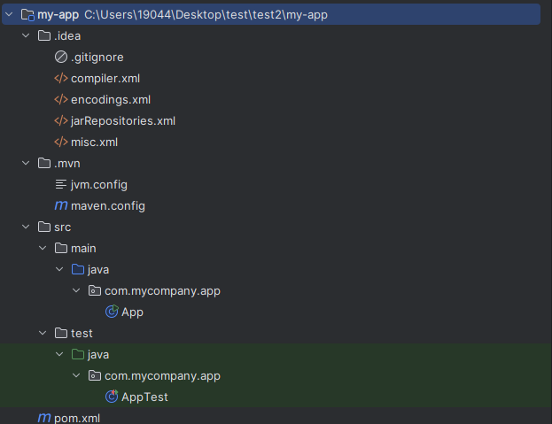
Maven Folder Structure
Maven command to create a project: mvn archetype:generate -DgroupId=com.mycompany.app -DartifactId=my-app -DarchetypeArtifactId=maven-archetype-quickstart -DarchetypeVersion=1.5 -DinteractiveMode=false

Slide 16
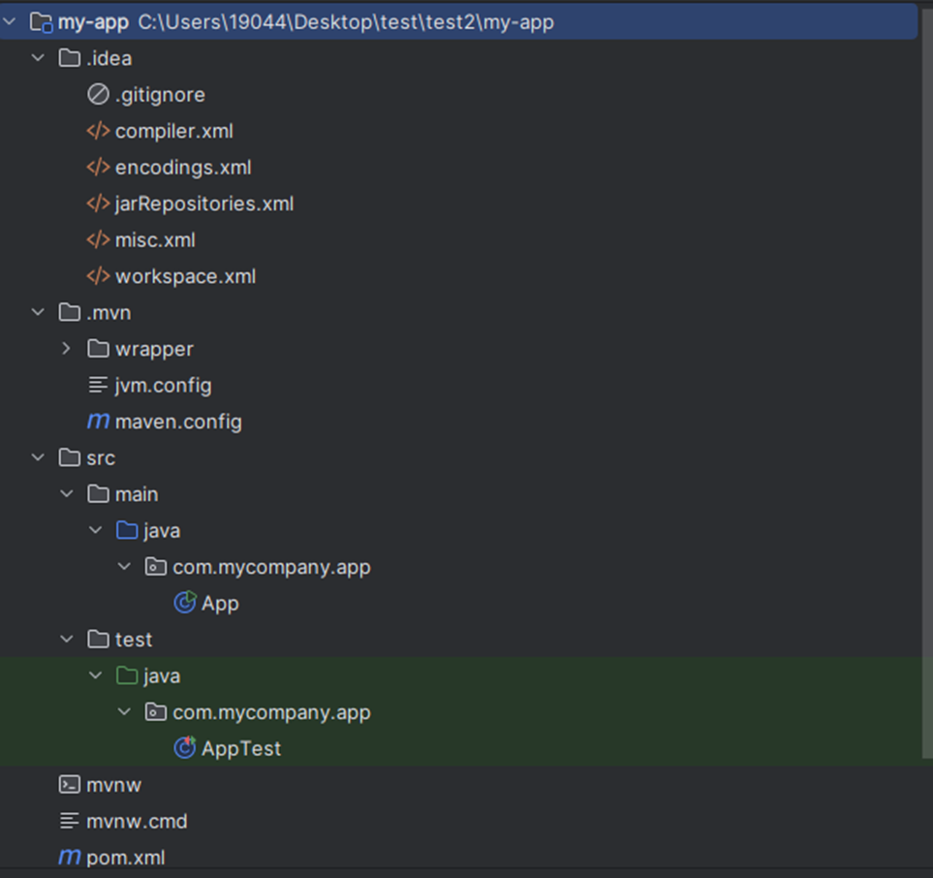
Maven Wrapper
Maven Wrapper Command:
mvn wrapper: wrapper
Three New Files Added:
.mvn/wrapper: Wrapper configuration
Mvnw: Script for Linux/Unix/Mac
Mvnw.cmd: Script for Windows
The Maven Wrapper allows you to embed Maven into your project directly, ensuring a consistent Maven version for all developers.

Slide 17
Maven as a Build Tool
What is a build tool?
A build tool automates the process of compiling, testing, packaging, and deploying software applications.
It manages the entire project lifecycle, ensuring consistency and efficiency in building and delivering applications.

Slide 18
Maven as a Build Tool
Maven commands:
mvn clean: Cleans the project by deleting the target/ directory.
mvn compile: Compiles the project's source code.
mvn test: Runs the tests for the project.
mvn package: Packages the compiled code into a JAR, WAR, or other deployable format.

Slide 19
Maven as Dependency Management
What is Dependency Management?
Dependency management refers to the process of managing the libraries and external components that your project depends on.
Key Features:
Stores dependencies definition in pom.xml
Automatic Dependency Resolution (Maven Central Repository)
Transitive Dependencies
Version Management

Slide 20
Maven as Dependency Management
The pom.xml (Project Object Model) file is the core configuration file in a Maven project. It is used to:
Store Dependency Definitions
Manage Project Information
Configure Build Settings
Dependency Installation:
When you install dependencies, Maven downloads them from remote repositories and stores them in a global local repository (~/.m2/repository), not in your project's local directory.
These dependencies are shared across all projects, which allows Maven to reuse them, reducing duplication and ensuring consistency.

Slide 21
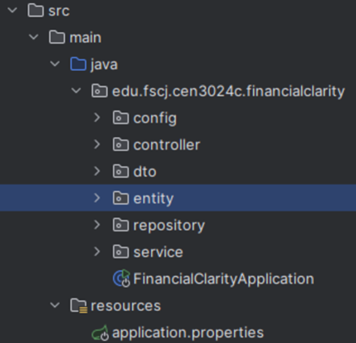
Spring Boot
Key Features of Spring Boot:
Spring boot built on top of Spring Framework
Used in Java-based applications
Opinionated framework
Application Accelerator
Embedded Server

Slide 22
JPA Hibernate
What is JPA (Java Persistence API)?
JPA is a Java specification for mapping Java objects to relational database tables.
Provides a standard API for persisting, retrieving, and managing data in a database.
Defines the contract for ORM (Object-Relational Mapping) frameworks.
What is Hibernate?
Hibernate is a popular ORM framework and an implementation of JPA.

Slide 23
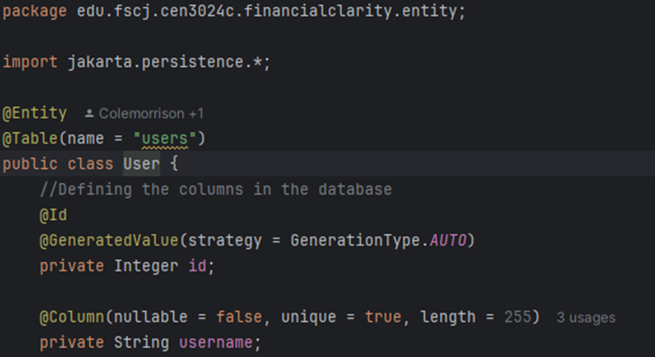
JPA Hibernate Example

Slide 24
Feature Branching Strategy
Steps:
Clone Repository
Create new branch “git branch branch_name”
Write code
Stage changes “git add .”
Commit change “git commit -m “my new feature”
Push branch to remote repository “git push origin branch_name”

Slide 25
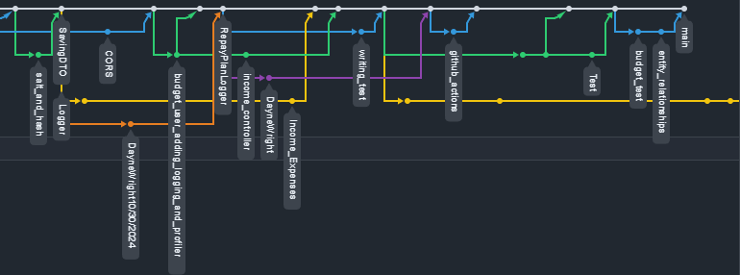
Feature Branching Strategy

Slide 26
Pull Request
Steps for Creating a Pull Request (PR)
Go to GitHub and open your repository.
Navigate to the Pull Requests tab and click New Pull Request.
Select your feature branch and set main as the target branch.
Request a review from a team member.
After the review, if the code is approved, ask them to merge the pull request.

Slide 27
APIs
Application Programming Interfaces (API) allow communication between application and clients
Enable users to interact with the application by retrieving or modifying data like budgets, expenses, and incomes.
APIs are used to
Act as a bridge between user and backend logic
Show application’s key feature through endpoints
HTTP Methods:
GET (Retrieve data)
POST ( Create new data)
PUT (Update existing data)
DELETE (REmove data)
Notes:
Hello my name is Anthony and I will be going over the backend development, terminology and the steps we took to ensure that oour application worked properly.
APIs, or Application Programming Interfaces, play a crucial role in our budget app by enabling seamless communication between the client-side interface and the backend where the app’s logic and data reside. Essentially, APIs act as a bridge, allowing users to interact with the application without needing to understand or directly engage with the underlying technical complexities. For example, through our API, users can retrieve or modify important data such as budgets, expenses, and incomes, making the app dynamic and interactive.
In practice, APIs expose the application’s key features through specific endpoints. These endpoints serve as access points for actions that the app can perform, ensuring the front-end can communicate effectively with the backend. APIs rely on HTTP methods to handle different operations. For instance, the GET method retrieves data, such as displaying a user’s expense history. The POST method is used to create new data, like adding a new income entry. When users need to update existing data, such as modifying a budget category, the PUT method comes into play. Finally, the DELETE method allows users to remove data, like deleting an old expense record they no longer need.
By leveraging these methods, the API ensures a smooth flow of information, enabling users to engage with the app’s core functionality intuitively and efficiently. This makes the API a vital component for connecting the front-end experience with the backend logic and delivering a seamless, user-focused application.

Slide 28
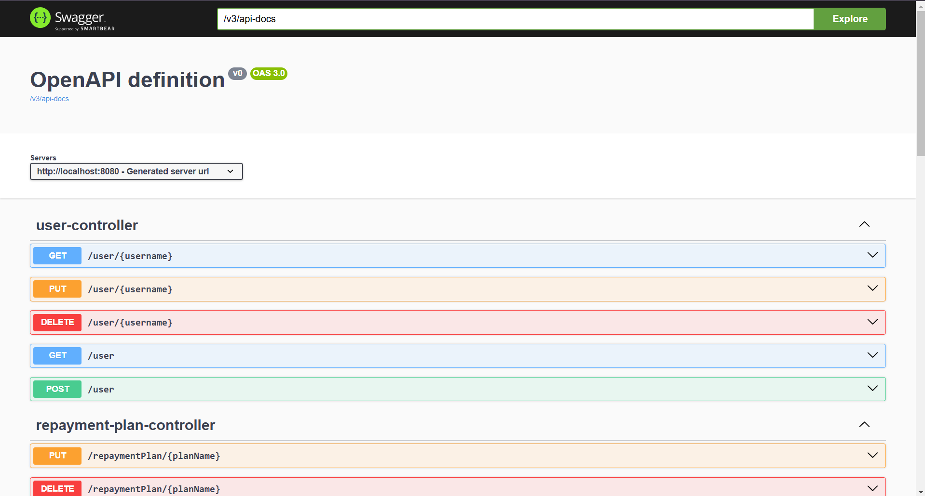
Endpoint
Endpoints are a specific URL that are used to access certain resources of functions for an API
The key endpoints in the application are
/budget
/expesnes
/income
repaymentPlan
/savings
/users
Swagger UI is an open-source tool that allows users to visualize and interact with an API
Notes:
Endpoints are specific URLs that provide access to particular resources or functions within an API. They serve as the connection points where the front-end or other clients can request data or perform actions. In our application, the key endpoints include /budget, /expenses, /income, /repaymentPlan, /savings, and /users. Each of these endpoints is designed to handle a specific aspect of the app’s functionality, ensuring that users can interact with the data they need efficiently. For instance, /budget might be used to fetch or update overall budgeting information, while /expenses and /income handle the detailed tracking of spending and earnings.
To streamline the process of exploring and interacting with our API, we will use Swagger UI. Swagger UI is an open-source tool that allows developers and users to visualize the API’s structure and interact with it directly in a web interface. It simplifies testing and understanding the API by providing a clear, interactive documentation format. With Swagger UI, developers can ensure that the endpoints function as intended while making it easier for others to understand and work with the API. This tool is especially helpful for collaboration and quality assurance as we develop the app further.

Slide 29
Entity
The purpose of entities is to represent the core data model or object in an application, often mapped to a database table. In this project the entities are Java classes used to specify how they are mapped to data structures
It creates and defines attributes of the data model including id, names, category, etc.
There are a total of 6 entities in the application:
Users
Describes type of user profile and additional attributes which include, but aren’t limited to\
Name
Email
Authorization credentials
Essential entity for an application
Used to help maintain personal information and secure data management.
Fields:
Id
Username
Email
Age
totalIncome
totalExpenses
Salt
Hash
Notes:
Entities are a crucial aspect of application development, as they represent the core data model or objects and are often mapped directly to database tables. In this project, entities are implemented as Java classes, which define how they are mapped to specific data structures. These entities establish the attributes of the data model, such as IDs, names, and categories, providing a structured and organized way to handle data within the application.
Our project includes a total of six entities, each serving a distinct purpose. One of the most important is the Users entity. This entity defines the type of user profile and includes various attributes, such as the user’s name, email, and authorization credentials. As an essential entity, it plays a key role in maintaining personal information while ensuring secure data management for the application.
The Users entity comprises several fields:
Id: A unique identifier for each user.
Username: The user’s display or account name.
Email: Used for communication and account-related functionalities.
Age: Tracks the user’s age, potentially for personalization or analytics.
totalIncome: Represents the user’s total income, integral to budgeting features.
totalExpenses: Records the total spending of the user to monitor financial activity.
Sal: Likely referring to salary or recurring income.
Hash: Ensures the secure handling of sensitive data, such as passwords.
By organizing the application’s data through entities like Users, we ensure a clear, reliable, and scalable structure for the project. These entities facilitate seamless data management, enhance security, and lay the groundwork for robust application functionality.

Slide 30
Entity (con.)
Budget
Represents overall financial plan for a user
It is used to manage and define a financial plan
Fields:
Id
userId
budgetName
timeCreated
Expenses
Used to categorize various expenses that a user may have
There is no limit to how many expenses a user can create
It uses a foreign key userId v
Fields:
expenseId
userId
Amount
Name
Income
Used to track a users income(s)
Allows for users input and allows them to manage their earnings overtime
Fields:
incomeId
userId
Amount
name
Notes:
Entities like Budget, Expenses, and Income play an integral role in structuring the data for our application, ensuring the financial management tools are robust and user-centric. These entities work together to help users organize, track, and manage their financial activities effectively.
The Budget entity represents the overall financial plan for a user. It serves as a framework for defining and managing a user’s financial goals and allocations. The fields in this entity include:
Id: A unique identifier for each budget.
userId: Links the budget to a specific user.
budgetName: The name assigned to the budget for easy identification.
timeCreated: Tracks when the budget was created, useful for record-keeping and monitoring.
The Expenses entity is used to categorize and track various expenses a user may have. Users can create as many expenses as needed, with no imposed limit, providing flexibility for financial tracking. This entity utilizes a foreign key, userId, to associate each expense with a specific user. The fields include:
expenseId: A unique identifier for each expense.
userId: Links the expense to the relevant user.
Amount: Records the cost associated with the expense.
Name: The name or category of the expense for clarity.
The Income entity is designed to track a user’s earnings over time. It allows users to input and manage their various income sources, supporting long-term financial planning. The fields in this entity are:
incomeId: A unique identifier for each income entry.
userId: Links the income entry to a specific user.
Amount: Represents the amount of income earned.
Name: The name or description of the income source.
Together, these entities create a comprehensive system for users to oversee their financial health. The Budget provides an overarching view of financial goals, while Expenses and Income allow for detailed tracking and management, ensuring users have complete control over their finances.

Slide 31
Entity (con.)
RepaymentPlan
Provides users a place to manage and track repayment schedules for loans and/or debts
Allows users to create a timeline of when they would like to have everything paid off
Fields
planId
userId
totalExpense
Payment
timeLIne
Category
planName
Savings
Lets users set and monitor savings goals
Goals can be labeled for specific purpose
Fields:
savingsId
savingsAmount
userId
Description

Slide 32
Controller
The purpose of controllers is to process requests for the client and return appropriate responses
They ensure smooth communication between application’s UI and backend logic, by calling appropriate services to process user input and them return the result.
In this application the main functions of the controllers are to:
Manages CRUD (Creating, Retrieving, Updating, and Deleting) operations
Data Conversion for Communication
Convert entity to Data Transfer Object (DTO) to ensure clean and organized data transfer between backend and client
Integration with Services
Utilizes Service class to save new data
Logging and Monitoring
Implements SLF4J logging for tracking application behavior, errors and performance
Notes:
The purpose of controllers in an application is to handle client requests and return appropriate responses, acting as intermediaries between the user interface and backend logic. They play a critical role in ensuring smooth communication between the front-end and the back-end by processing user input, invoking the necessary services to perform actions, and then returning the results to the client in a structured format.
In this application, the controllers serve several key functions:
Manages CRUD operations: The controllers handle the core functionality of the application, including creating, retrieving, updating, and deleting data. They ensure that the necessary actions are carried out in response to client requests, allowing users to interact with the system and manipulate data as needed.
Data Conversion for Communication: Controllers are responsible for converting entities into Data Transfer Objects (DTOs). This conversion ensures that the data exchanged between the backend and the client is clean, structured, and easy to work with. By using DTOs, the application separates the internal data structure from the data presented to the client, improving security and maintainability.
Integration with Services: Controllers interact with the Service class to perform operations on the data. For example, when a new piece of data is created, the controller will call the appropriate service method to save that data to the database. This ensures that business logic is kept in the service layer while the controller focuses on handling user requests.
Logging and Monitoring: The controllers implement SLF4J logging to track the behavior of the application, errors, and performance. This is crucial for monitoring the system’s health, diagnosing issues, and understanding how the application behaves under different conditions. Logging also helps developers track user interactions and application flow for debugging and optimization purposes.
In summary, controllers act as the backbone of request handling, ensuring that data is properly processed, converted, and communicated between the user interface and the backend system. They also help maintain a clean architecture by integrating with services, managing CRUD operations, and logging critical application information.

Slide 33
DTO
Data Transfer Object (DTO) design pattern used to transfer data between different layers or systems
They help to simplify data exchange, improve maintainability and ensure security
In this application the DTO is used to:
Facilitates Data Transfer
Decouples Layers
Separate entity layer from presentation layer, ensuring backend details are not seen by client
Enhance code maintainability
Ensures changes in database structure doesn’t directly impact API layer, updates are reflected in DTO mapping
Bidirectional Support
Works for both outgoing and incoming data
Notes:
The Data Transfer Object (DTO) design pattern is a crucial technique used to transfer data between different layers or systems within an application. It simplifies data exchange, improves maintainability, and ensures better security by abstracting the details of the data. By using DTOs, we can manage how data is sent and received, preventing unnecessary exposure of sensitive or complex information.
In this application, the DTO is used for several important purposes:
Facilitates Data Transfer: DTOs serve as containers for data that need to be transferred between layers, such as from the backend to the front end. By structuring the data in a specific format, DTOs ensure that only the necessary information is passed along.
Decouples Layers: The DTO pattern helps to decouple the layers of the application. By separating the entity layer (which is responsible for interacting with the database) from the presentation layer (which is responsible for displaying data to the user), we ensure that sensitive backend details are not exposed to the client. This improves the security and clarity of the application.
Enhances Code Maintainability: Using DTOs helps improve the maintainability of the codebase. If there are any changes in the database structure, the entity layer can be updated without affecting the API layer. The DTOs simply need to be updated to reflect these changes, ensuring that the client-facing API remains stable and easy to use.
Bidirectional Support: DTOs support both incoming and outgoing data. When data is received from the client (incoming), it can be mapped from the DTO to the entity layer, and when data is sent to the client (outgoing), it can be transformed from the entity layer into the DTO. This ensures that data flows smoothly in both directions while keeping the client and server logic separate.
In summary, the DTO design pattern plays a key role in making the application more secure, maintainable, and efficient by ensuring that data is transferred properly between layers, while abstracting the underlying complexity from the client.

Slide 34
Repository
Repositories are a container used for digital storage to maintain and change data. It allows developers to interact with a database without needing to write SQL queries manually
In this application the Repository class
Utilities the JpaRepostiory API
Saves and updates records
Retrieves all records from database
Utilizes custom queries
findBy
Fetches entity by name
deleteBy
Deletes by name
Notes:
Repositories are essential components in an application’s data layer, acting as a container for digital storage and enabling the management of data. They abstract the interaction with the database, allowing developers to interact with it without the need to manually write complex SQL queries. This not only simplifies the development process but also makes the code cleaner and easier to maintain.
In this application, the Repository class utilizes the JpaRepository API, a part of Spring Data JPA, which provides built-in methods to manage the persistence of data. The JpaRepository API simplifies many common database operations, such as saving and updating records, as well as retrieving data from the database.
The Repository class in this application serves several key functions:
Saving and updating records: It allows data to be persisted in the database or updated if changes are made to existing records.
Retrieving records: It fetches all records from the database, making it easy to access and manage the data.
Custom queries: The Repository class supports custom queries for more specific data retrieval needs. For example, findBy() is used to fetch entities by a specific attribute like name, allowing for more targeted data retrieval. Similarly, deleteBy() is used to delete entities by a given attribute, such as name, providing a streamlined way to remove data from the database.
Overall, the Repository class simplifies database interaction by abstracting the complexities of SQL and providing a clean, efficient way to handle data operations

Slide 35
Service
Service acts as a bridge between controllers and repositories
It centralizes logic for consistent data handling and supports reusable and scalable workflow
The Service class:
Retrieves Data
Utilizes methods
finalAll()
findyBy()
Data Management
Calls methods
save()
Data deletion
deleteBy()
Notes:
The Service layer plays a crucial role in the architecture of the application, acting as a bridge between the controllers and repositories. It centralizes the business logic, ensuring consistent data handling and supporting a more organized and scalable workflow. By managing the interaction between the front-end controllers and the back-end repositories, the Service layer streamlines the process and ensures that data is handled correctly throughout the application.
One of the primary functions of the Service class is to retrieve data. It does this by utilizing various methods, such as findAll() and findBy(), which allow the application to retrieve data based on specific conditions or to fetch all entries from the database. These methods are essential for handling data retrieval efficiently.
In addition to data retrieval, the Service layer is responsible for data management. It calls methods like save() to persist new data or updates to the database, ensuring that the application’s state remains accurate and up-to-date. The Service class also handles data deletion through methods like deleteBy(), which ensures that obsolete or unnecessary data can be removed from the system as needed.
Overall, the Service layer centralizes key functions, making the application more efficient, organized, and easier to maintain. It ensures that data handling is consistent and that the application’s workflow is reusable and scalable, which is essential as the application grows.

Slide 36
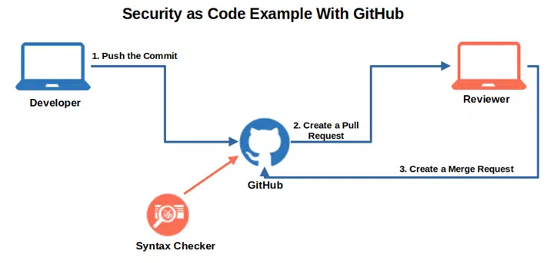
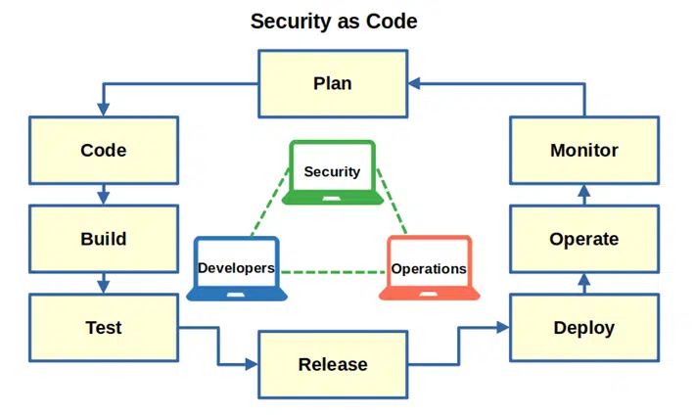
Security Implementation
For our application we went with a more (SaC) security as code approach to implementation
We utilized some predefined code to help with with security and assessments
Gut hub was also very helpful in finding our vulnerabilities and any errors
This approach for security was the best way for our group
We also utilized some other security features mentioned by our instructor
Notes:
Salt and Hash
CORS

Slide 37
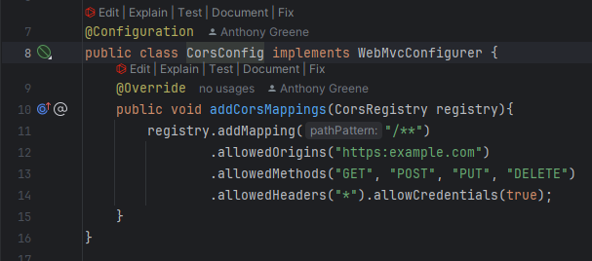
CORS
CORS stand for Cross-Origin Resource Sharing is an HTTP-header-based mechanism
Explicitly allowlist certain origins
And helps bypass the same-origin policy
CORS will create a preflight request before the actual request
With the help of CORS we are able to secure our API endpoints
@CrossOrigin
@AllArgsConstructor
@RestController
@RequestMapping(“api/v1/expenses)
Which helps keep our data from being leaked from the backend through certain applications

Slide 38
Salting and Hashing
We are aware that the user needed security for authentication to prevent breaches.
We utilize both Salt and Hash code to achieve this.
Hashing takes value of a previous data and makes it something else
Salt creates another layer of protection to hash by making unique hash value
salting makes it so that same passwords have different hashes to know the difference
public String getSalt() {return salt;}
public void setSalt(String salt) {this.salt = salt;}
Hashing will make so that the stored users passwords have to be deciphered to understand
public String getHash() {return hash;}
public void setHash(String hash) {this.hash = hash;}

Slide 39
Security for the future
Things we want to add for the next class
Have a secure state
Keep sensitive data safe
Minimize attack surfaces from threat actors
Deleting lines of code and duplicate APIs
And have a separation of duties
Least privileging
With these added we can ensure the privacy and safety of our data and the users
While minimizing any fatal errors in the launch of our app

Slide 40
Testing
The purpose of testing in an application is to make sure that all functions work as expected
Testing looks for and resolves bugs and ensure that each layer (ex. service and repository) work properly
Testing Methodology
Unit Testing
Tests individual components or methods in isolation
Mocking Dependencies
@Mock annotation utilized to mock behavior of repository layer, ensures independence of tests from database
Assertions
The assertThat method from AssertJ assert output values against results expectations
The two tests in this applications are
UserRepostiroyInMemoryTest.java
Verifies that the repository correctly performs basic database operations
Ensures the integrity of database interactions and correctness of customer query methods
UserServiceTest.java
Verifies business logic implemented in service layer of application
Uses Mockito to mock dependencies, testing various methods within the UserService class
Notes:
Testing is a crucial part of the application development process, as it ensures that all functions perform as expected. It helps identify and resolve bugs, providing confidence that each layer of the application, such as the service and repository layers, operates properly. By thoroughly testing our application, we ensure that it runs smoothly and reliably for users.
In terms of testing methodology, we use unit testing, which focuses on testing individual components or methods in isolation. This approach allows us to verify that each part of the application works correctly without interference from other components. To ensure independence during testing, we make use of mocking dependencies. Specifically, we use the @Mock annotation to mock the behavior of the repository layer, allowing the tests to run without relying on the actual database. This method helps us isolate the logic we’re testing, making the tests faster and more focused.
We also use assertions to verify that the results returned by the application match our expectations. The assertThat method from AssertJ is employed to compare output values against predefined results, ensuring that the application behaves as intended.
Two main tests are conducted in this application:
UserRepositoryInMemoryTest.java: This test ensures that the repository layer correctly performs basic database operations. It verifies the integrity of database interactions and checks the accuracy of customer query methods.
UserServiceTest.java: This test validates the business logic implemented in the service layer. It uses Mockito to mock dependencies, allowing us to test various methods within the UserService class and confirm that they work as expected under different conditions.
By using these testing methods, we ensure that both the data layer and business logic are functioning correctly, which ultimately leads to a more reliable and efficient application.

Slide 41
Conclusion
Next semester, our primary focus will shift to the front-end development of the project. This will involve designing and building an intuitive and user-friendly interface that enhances the overall user experience
Key areas of development include:
User Interface (UI) Design
Crafting a visually appealing layout that aligns with modern design principle
Incorporating user feedback to ensure the interface meets their needs and expectations
Responsive Design
Ensuring the application functions seamlessly across devices, including desktops, tables and smartphones
Adopting a responsive design that adapts to mobile devices and web classes
Cross-Browser Compatibility
Testing and optimizing the application to perform consistently across major web browser, such as CHrome, Firefox, Safari and Edge
Addressing any potential discrepancies to maintain a unified user experience
Languages and tools to be Used
HTML
Structuring the content and elements of the application
CSS
Styling the interface for an engaging visual appeal and responsive design
JS
Adding dynamic functionality to enhance interactivity and usability
Notes:
Next semester, our primary focus will shift to the front-end development of the project. This phase is crucial as it involves building an intuitive and user-friendly interface that will enhance the overall user experience. One of our main goals is to create a visually appealing user interface (UI) that is in line with modern design principles. By incorporating user feedback into the design process, we’ll ensure that the final product not only meets but exceeds the expectations of the end-users.
In terms of design, we will prioritize responsive design to ensure the application functions seamlessly across a variety of devices, including desktops, tablets, and smartphones. A responsive layout will ensure that the app adapts and provides an optimal viewing experience on different screen sizes, making it accessible and easy to use for all users. Additionally, we will focus on cross-browser compatibility, testing the application across popular browsers like Chrome, Firefox, Safari, and Edge to make sure that it performs consistently. Any discrepancies will be addressed to ensure a unified and smooth experience, no matter how users access the app.
Regarding the technologies we’ll be using, the foundation of the front-end will be built with HTML, which will structure the content and define the layout of the application. CSS will be used for styling, making the interface visually engaging and responsive. Finally, JavaScript will add the dynamic functionality necessary for interactivity, ensuring the app is both engaging and usable.
By focusing on these areas, we aim to create a front-end that is not only visually attractive but also smooth, responsive, and user-friendly, setting a strong foundation for the next stages of development

Slide 42
Work Cited
Biam, Liron. “7 Principles of Secure Design in Software Development.” Jit, 11 June 2024, www.jit.io/resources/app-security/secure-design-principles. Accessed 20 Nov. 2024.

